Slide 1
Wing Tat Industrial (HK) Co., Ltd.
Company Profile
DongGuan Wing Tat Industrial Co., Ltd.
DongGuan Po Dan Industrial Co., Ltd
Talent comes from diligence,
and knowledge is gained by accumulation.

Slide 2
WELCOME
——歡迎頁——
Challenge is opportunity, breakthrough is growth.

Slide 3
Our Group Companies
01
02
03
WING TAT INDUSTRIAL
(HK) CO., LTD
DONGGUAN WING TAT INDUSTRIAL CO., LTD
DONGGUAN PO DAN INDUSTRIAL CO., LTD
The headquarters of Wing Tat’s Group, located in Tuen Mun Hong Kong, handling all the Group’s finance & accounting, purchasing and logistic activities.
Address: Wing Tat Industrial (HK) Co., Ltd Block G-I, 10/F Wai Cheong Industrial Centre, 5 Shek Pai Tau Road, Tuen Mun, Hong Kong
The factory of Wing Tat, located in Mainland China, handling all the
manufacturing and oversea business.
Address: DongGuan Wing Tat Industrial Co., Ltd
No. 3, Lin Dong San Road, Lin Cun, Tangxia, Dongguan, Guangdong China
A group member of Wing Tat, managing all the local business and
promotion in China.
Address: DongGuan Po Dan Industrial Co., Ltd
No. 3, Lin Dong San Road, Lin Cun, Tangxia, Dongguan, Guangdong China

Slide 4
Background
Wing Tat Industrial （HK) Co. Ltd.
Wing Tat was established in 1988 by a mold maker in Hong Kong, our President: Mr. Yuen Po Chu.
In 1995 we started our injection molding business.
Our production facilities were moved to Mainland China in 1998.
We have over 30 years of experience in the plastic industry.
Wing Tat specializes in plastic injection mold making, molding and small-scale assembly.
Our head office is located at Tuen Mun HK.
Our factory is located at Tangxia Dongguan Guangdong China.
We are ISO 9001 certified since 2001 and have upgraded this certificate in 2018.
We have used ERP system since 2006 and have upgraded to ERP 9.0 in 2019

Slide 5
Development Path
Relocated to China from HK
(Dong Guan Wing Tat Industrial Co., Ltd was founded)
Moved Factory to Tangxia Lin Cun
Factory established-tool making only
Wing Tat Industrial (HK) Co., Ltd was founded
LSR Production was Set up
1998
2015
2018
1988
1995
2017
2001
Dong Guan Po Dan
Industrial Co., Ltd was founded
Injection Molding business
Started
Moved Factory to Tangxia Si Cun from Yan Tian

Slide 6
Organization Chart
President
Yuen Po Chu
Director
Financial Officer
General Manager
Operation Director
HK Office
Admin
Engineering
Tooling
Production
Quality
Accounting
Finance
Project
QA
CNC
Injection
Shipment
HR
Tool Design
QC
EDM
Assembly
Storage
Purchasing
Fitting
PMC
Security
Warehouse

Slide 7
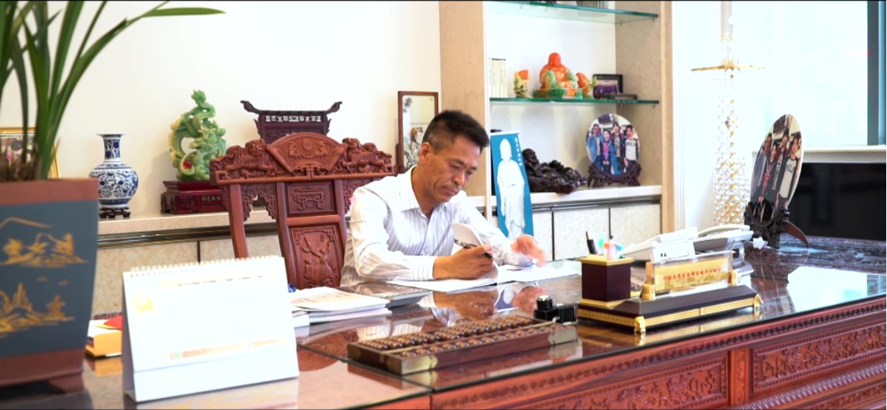
Our President
Mr. Yuen Po Chu reveals to our customers:
“I will put my heart in your hands and I
will show you how sincere I am.”
Mr. Yuen Po Chu always says to Wing Tat’s
employees:
“Team spirit is the core of enterprise’s culture.”
Mr. Yuen Po Chu
President

Slide 8
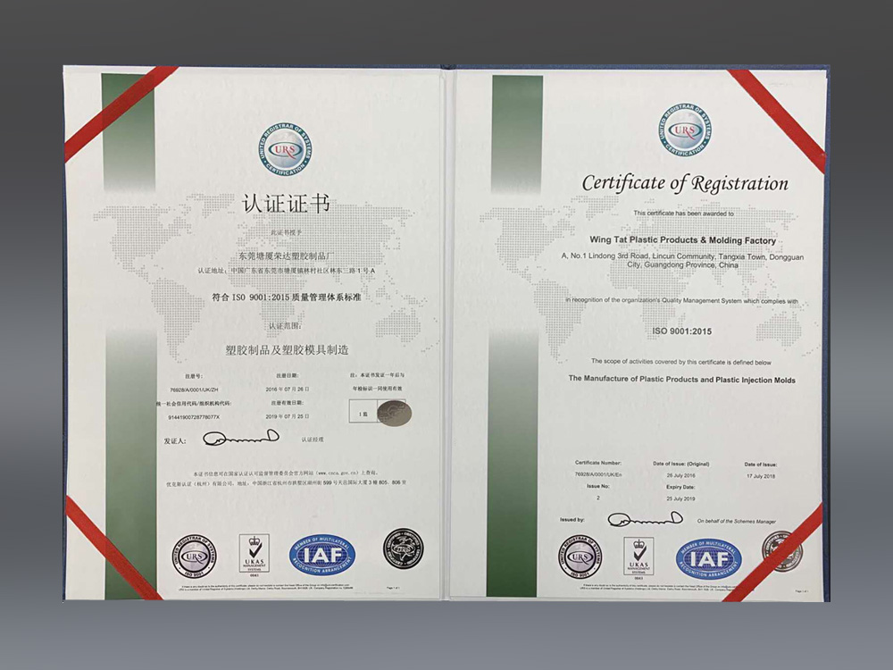
Certificate of Registration
ISO9001:2015 certified to Year 2018

Slide 9
Hong Kong Office
HK Office
HK Conference Room
The staff in our HK Office manage all the accounting, oversea purchasing, orders handling and shipment activities.
We also have a warehouse in HK for temporary storage of raw materials and finished goods before delivery.

Slide 10
China Factory
Our Injection molding Building
Our Logistics
Total floor area is 15,000 square metres.
Total number of employees is around 280.
Four buildings, including main office, injection & assembly workshops, tooling workshop and dormitory.

Slide 11
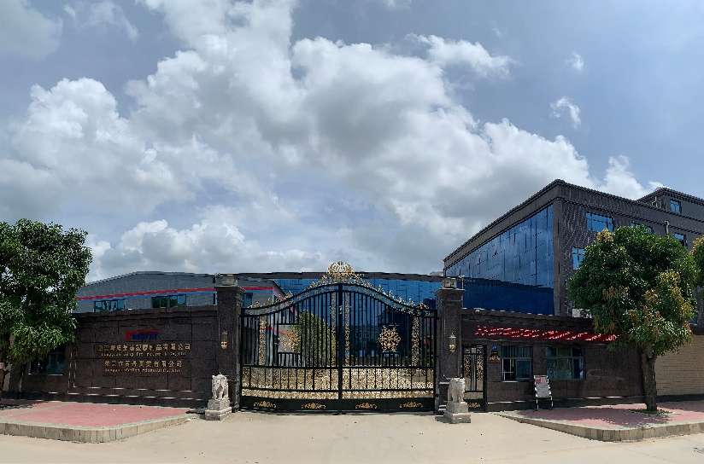
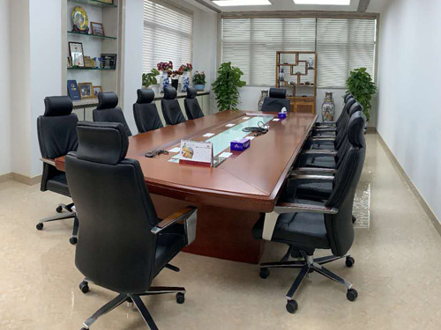
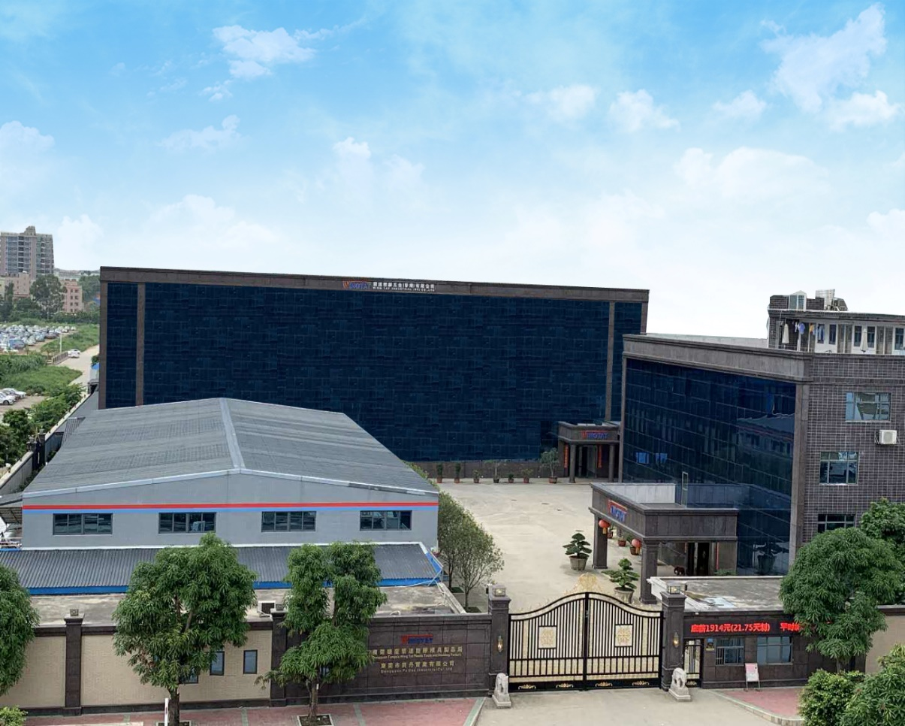
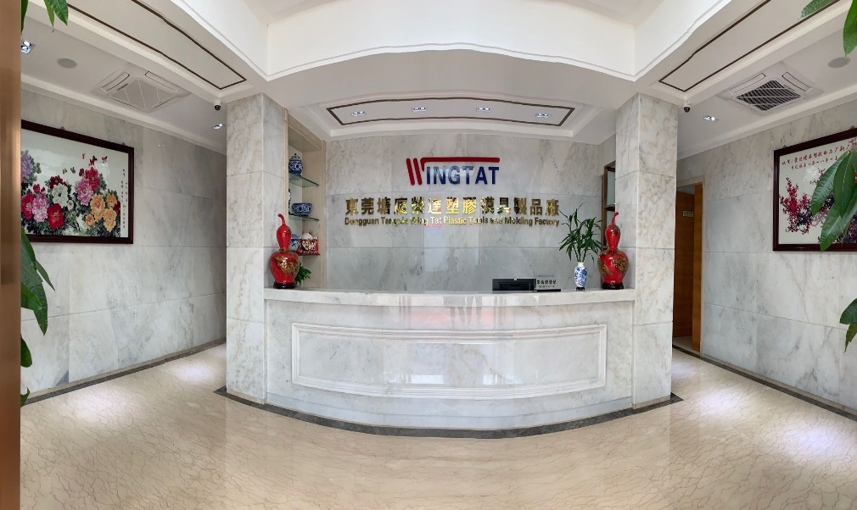
China Factory
Our Factory Gate
Our Conference Room
Our Reception

Slide 12
China Factory
Our Reception
Our Main Office
Robotic Arms for Injection Molding Machines
Our Injection molding workshop
Our Warehouse
Silicone Injection molding workshop

Slide 13
One Stop Integrated Service Provider
Tooling Making
Engineering
Mold Design
Mold Flow Analysis
Project Management
Plastic Injection Tools
LSR Tools
Jigs/Fixtures
Components
Exports
One Stop Integrated Service
Services
Product Assembly
Spray Painting
Pad/Silk-screen Printing
Ultrasonic Welding/Heat Staking
Laser Marking
Conventional Molding
Insert/Overmolding
IMD Lens Molding
LSR Molding
2K Molding
Services
Injection Molding
Assembly

Slide 14
Products 1
Transmitters
Heart Rate Monitors
Products 1
Wrist Straps
Wearable Products
Watch Components
Diving Devices

Slide 15
Products 2
Satellite Phones
Monitoring Products
Products 2
Bike Products
Electronic
Devices
Electronic Products
Computer Products

Slide 16
Products 3
Dental Products
Asthma Inhaler Products
Products 3
Health Care Devices
Eye Checking Devices
Shower Products

Slide 17
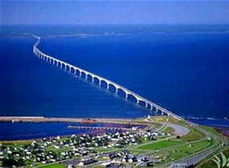
Marketing Network
Business Coverage
Europe
85%
Asia
10%
America
5%

Slide 18
Tooling Capability
Project Management
engineers
Tooling design engineers
x6
x4
Tooling Capability
Mold flow analysis engineer
Tooling makers
x30
x1
We can build 40 sets of tools per month
20% of our tools will be exported

Slide 19
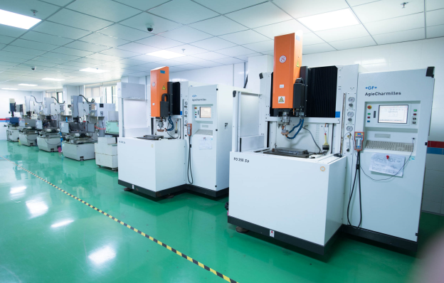
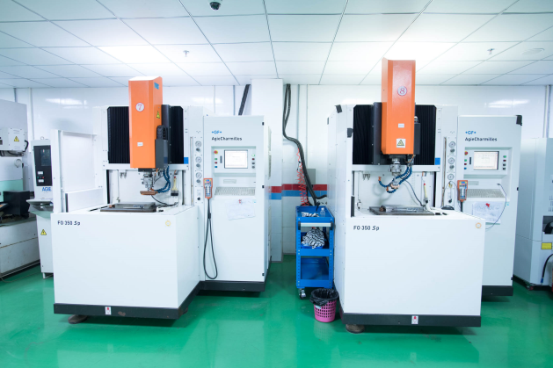
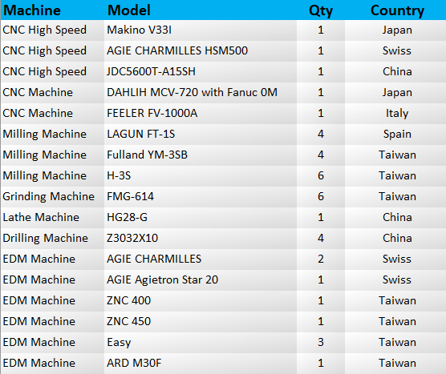
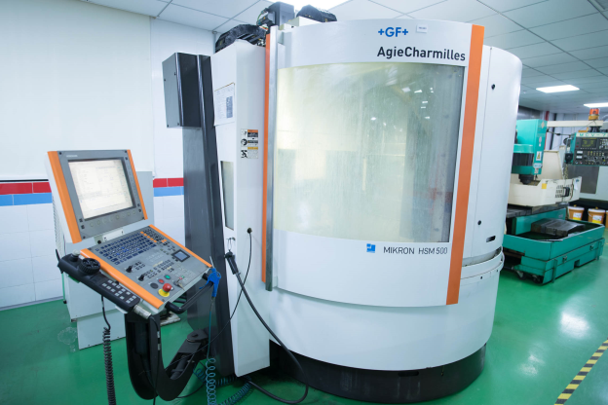
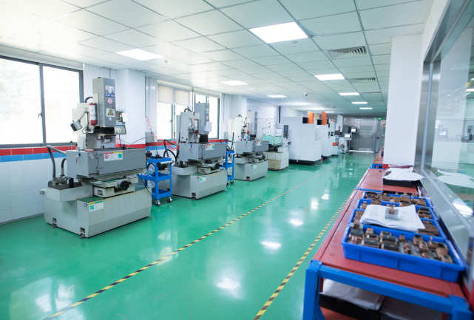
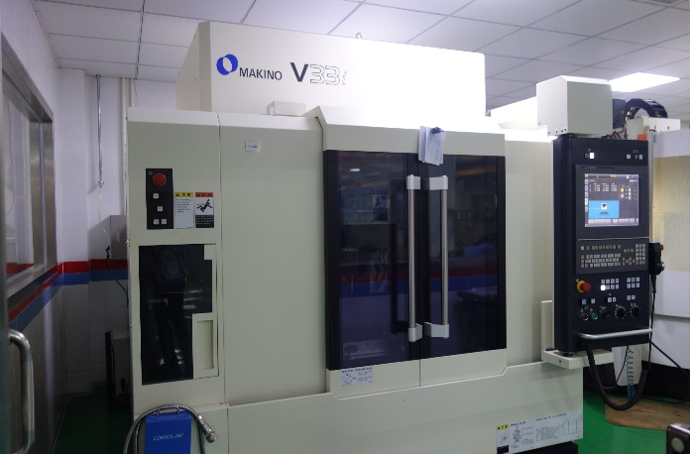
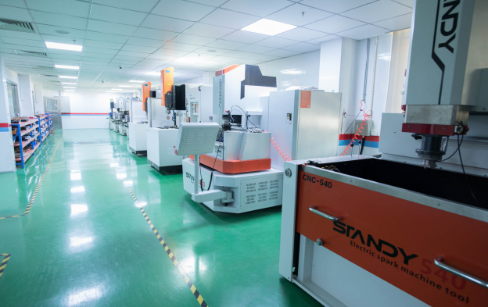
Mold Making Facilities
· CNC Machining Centre (x5)
· Milling Machine (x14)
· EDM Machine (x9)
· Grinding Machine (x6)
· Lathe and drilling (x5)

Slide 20
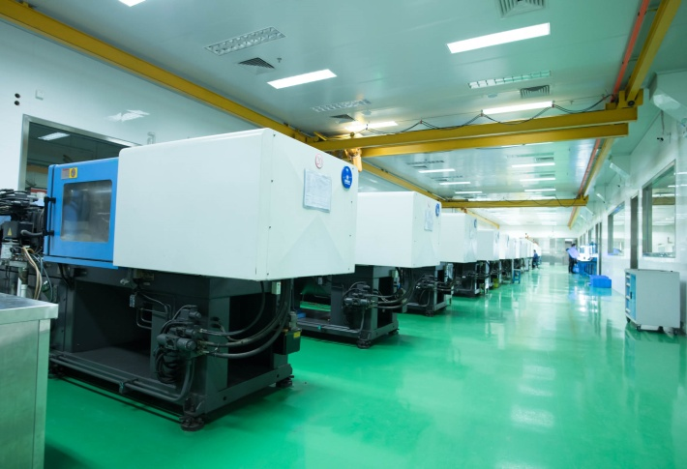
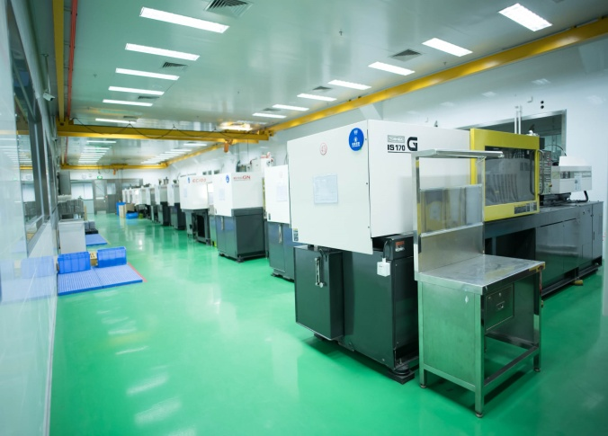
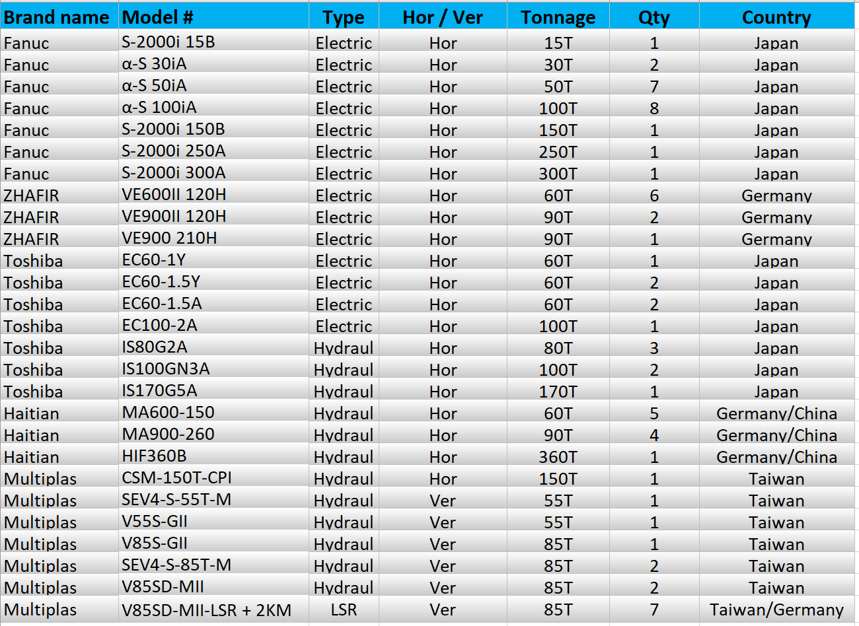
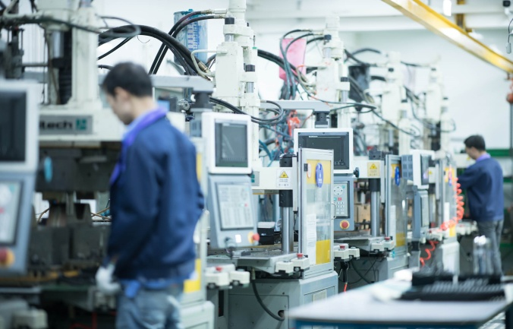
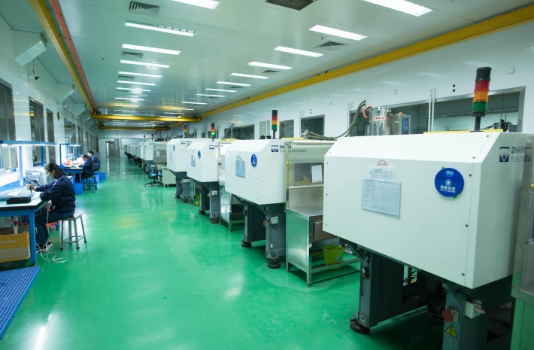
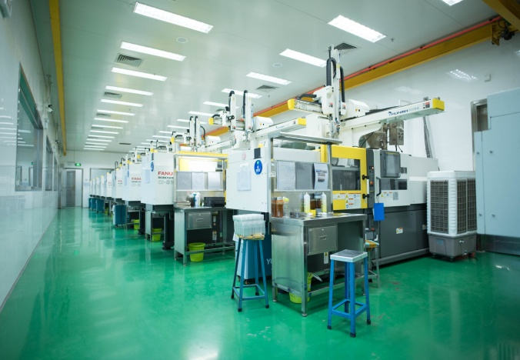
Injecting Molding Facilities
Totally 67 molding machines from 30T to 360T
· Hydraulic Injection Molding Machines (x16)
· Electrical Injection Molding Machines (x36)
· Vertical Injection Molding Machines (x7)
· Vertical LSR Injection Molding Machines (x7)

Slide 21
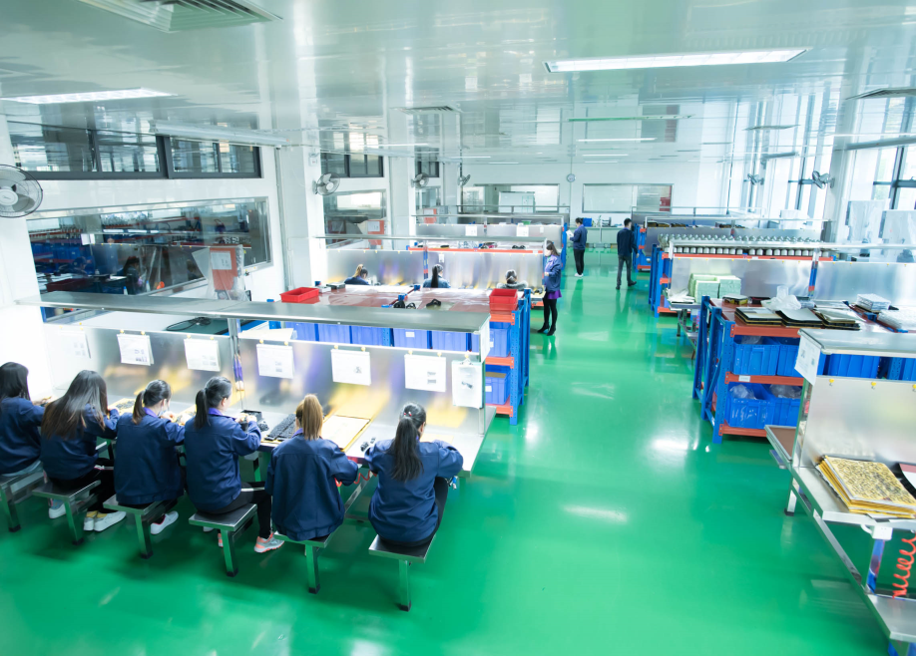
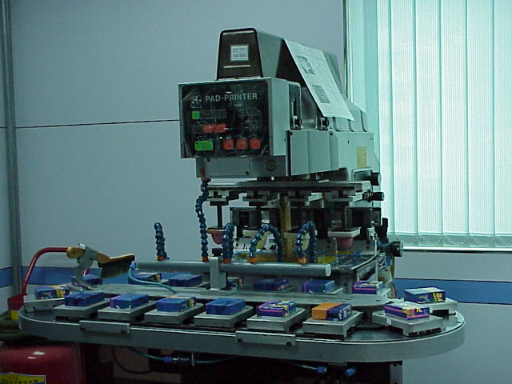
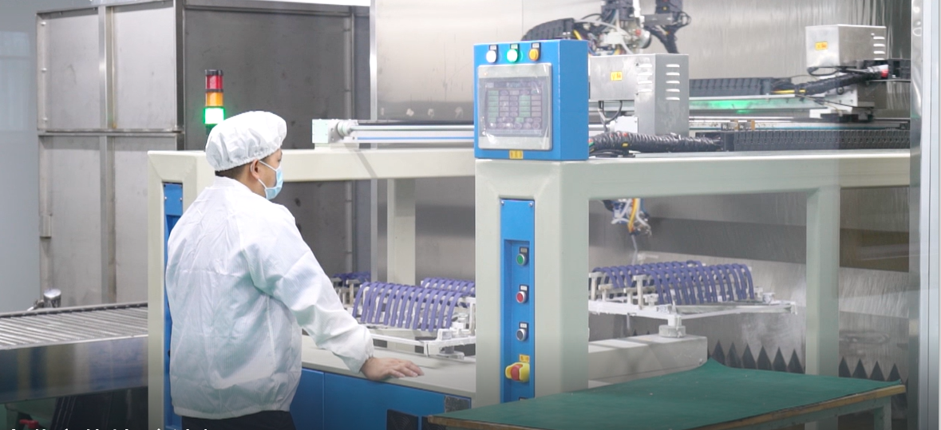
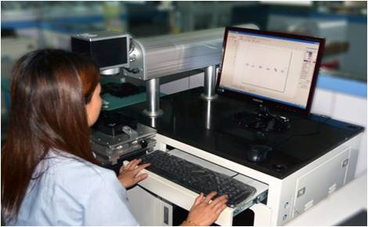
Secondary Operation Facilities
· Tampo Print Machines (x6)
· Ultrasonic Machines (x11)
· Laser Machine (x1)
· Plasma Machine (x1)
· Automatic Painting M/C (x2)

Slide 22
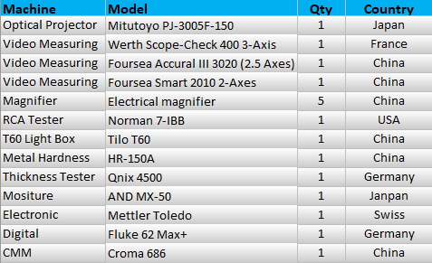
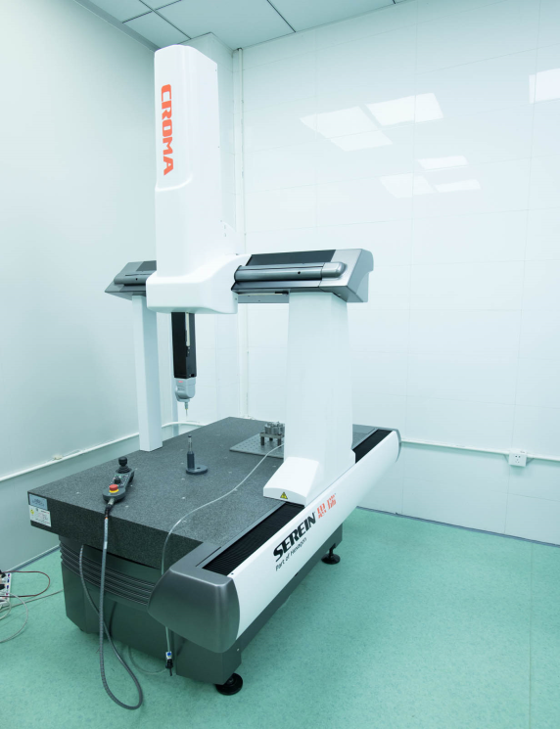
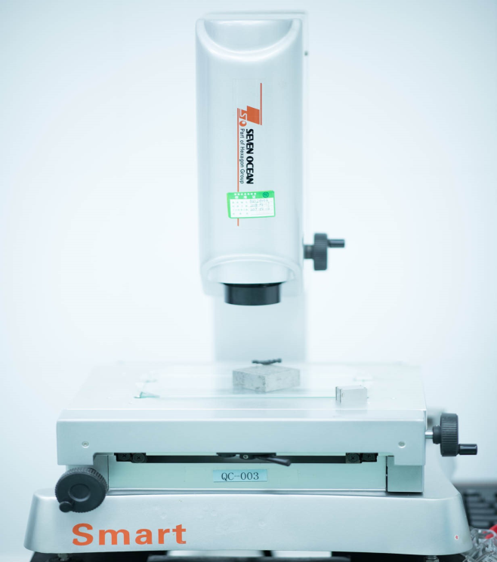
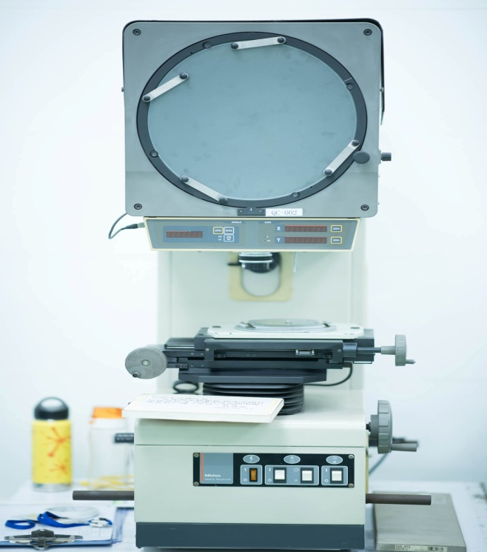
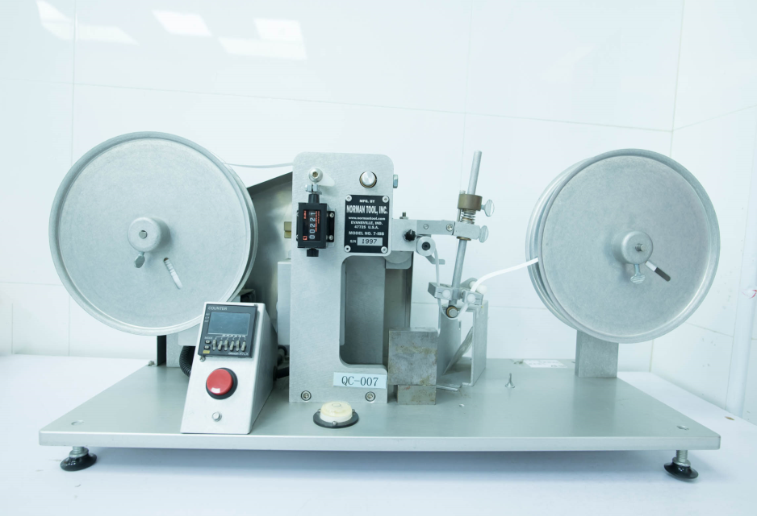
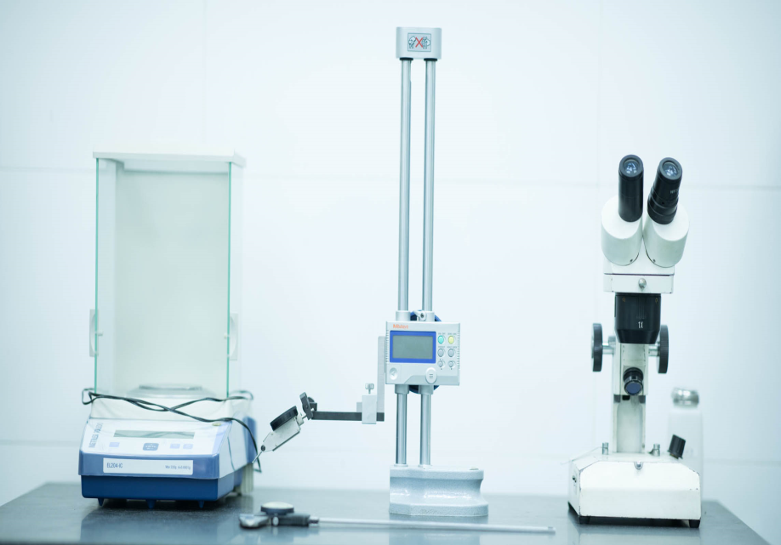
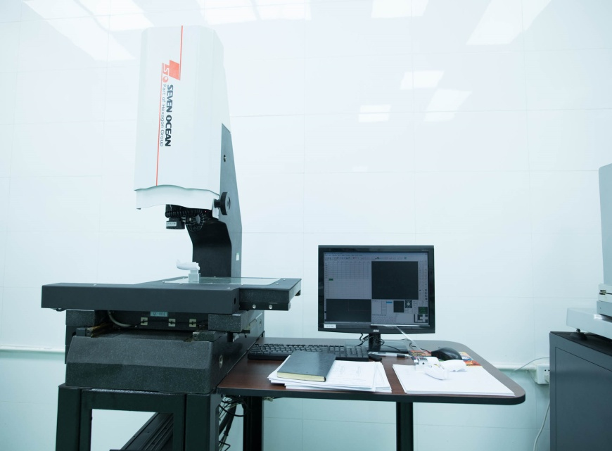
Measurement Facilities

Slide 23
Softwares
ERP
Digital China Management System
E-Fly ERP 9.0 System
Analysis
CAD/CAM
AutoCAD 2014 (for mold design and general drafting)
AutoDesk Mold Flow MPA 8.1
Unigraphics NX12

Slide 24
Operation Philosophy
02
03
01
Quality
Efficiency
Honest
04
05
Innovation
Humanization
Top quality comes from first class management.

Slide 25
Development and Technology Roadmap
2021
2020
2020
2018.12
LSR 2K Molding
Metal Parts Manufacturing
Low Pressure Injection Molding
Laser Engraving Machine
CMM Measuring Machine
LSR Vacuum Molding

Slide 26
Energetic Team
电子产品
电子产品
电子产品
We are a united team
Team Culture

Slide 27
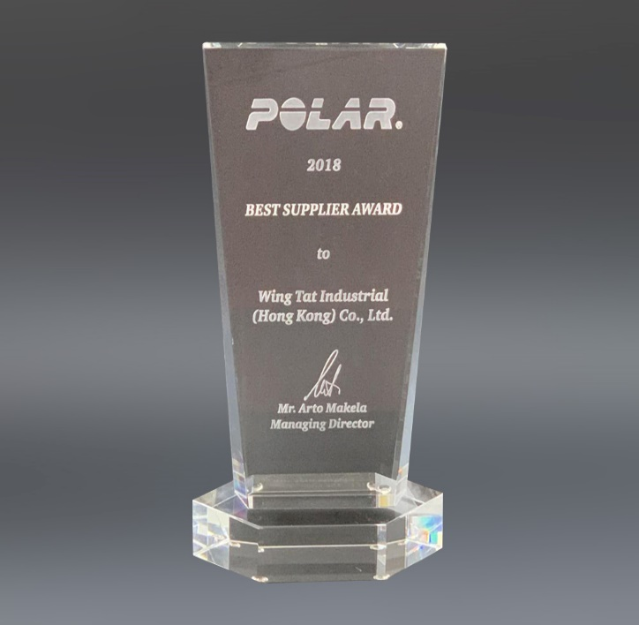
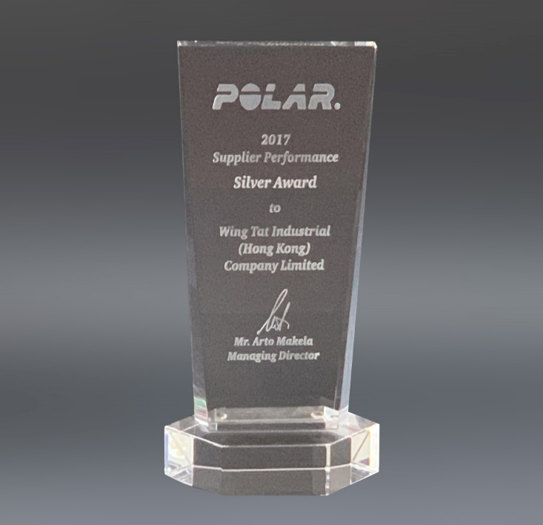
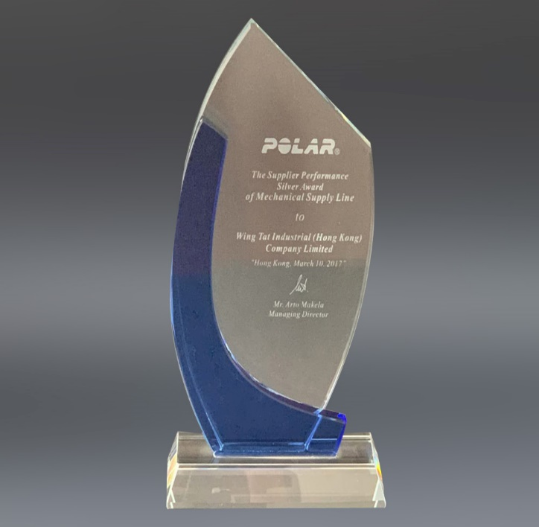
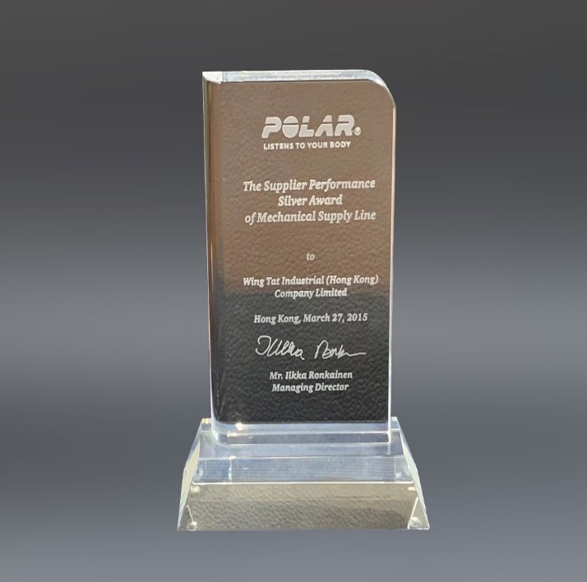
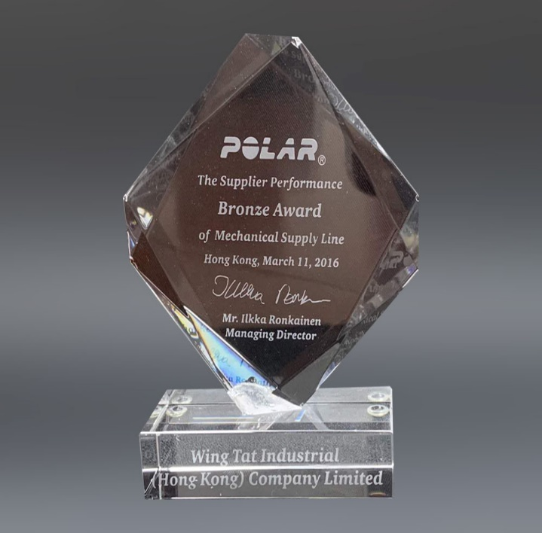
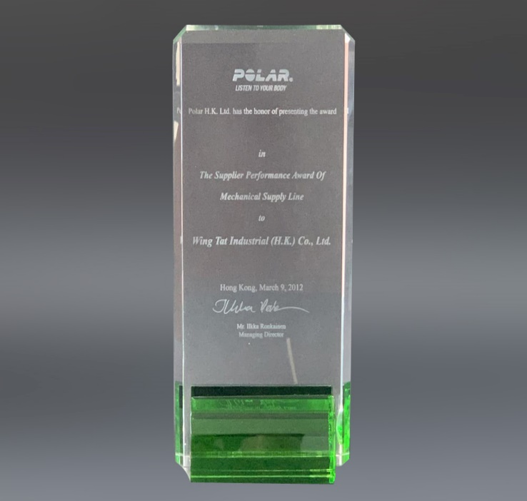
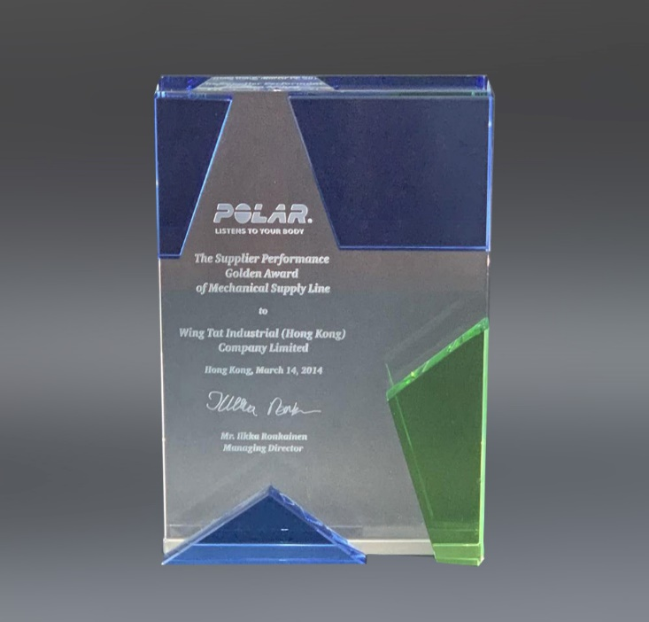
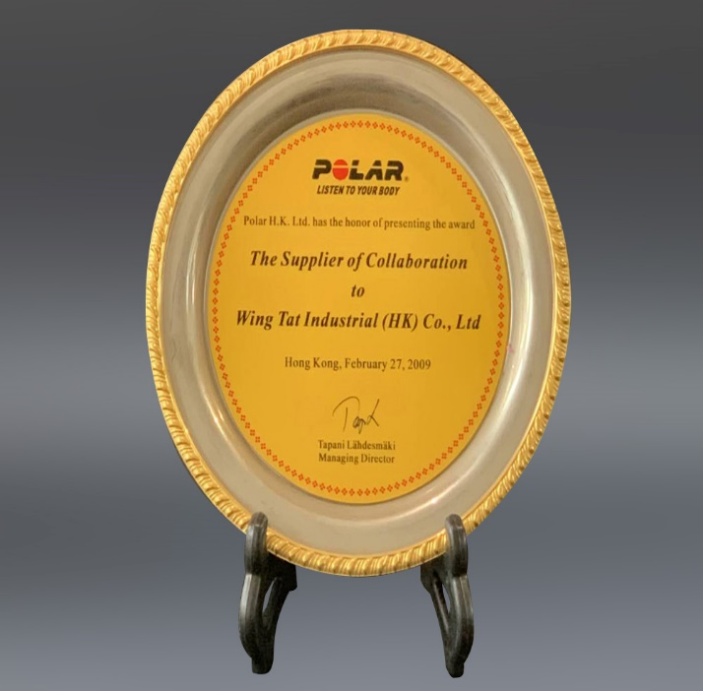
Honor Moment
2017
Best Supplier Award
Supplier Performance Sliver Award
Mechanical Supplier Line Sliver Award
Mechanical Supplier Line Sliver Award
2018
2017
2015
The Supplier Performance Award
Mechanical Supplier Line Golden Award
The Supplier Performance Award
The Supplier of Collaboration Award
2016
2014
2012
2009

Slide 28
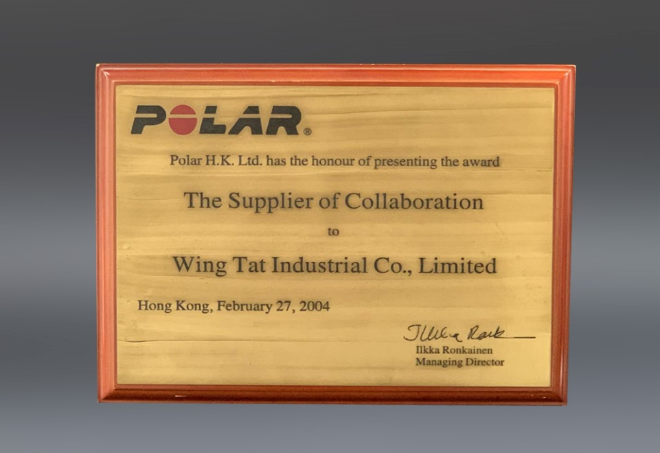
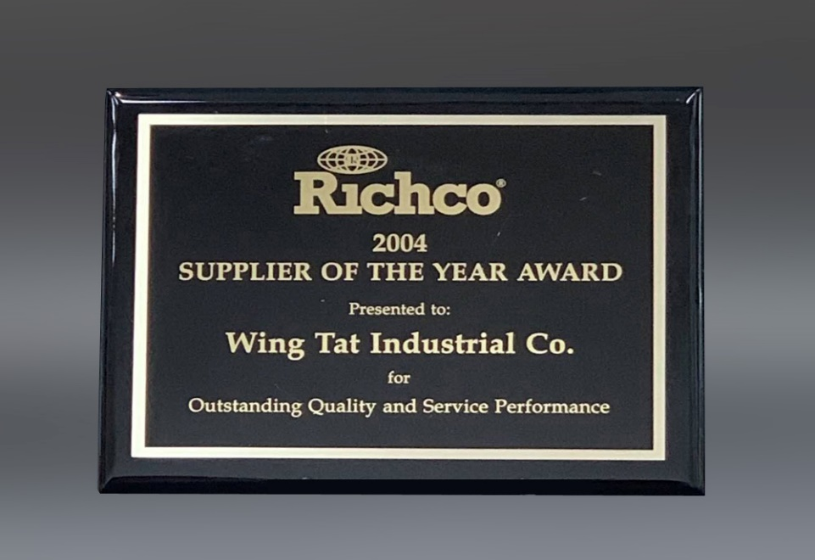
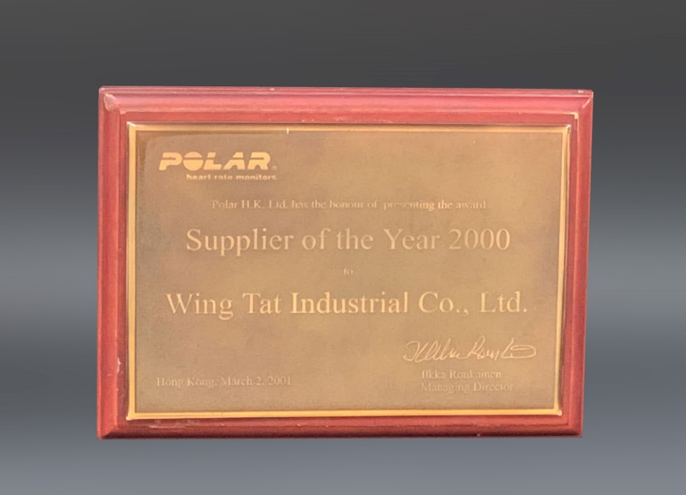
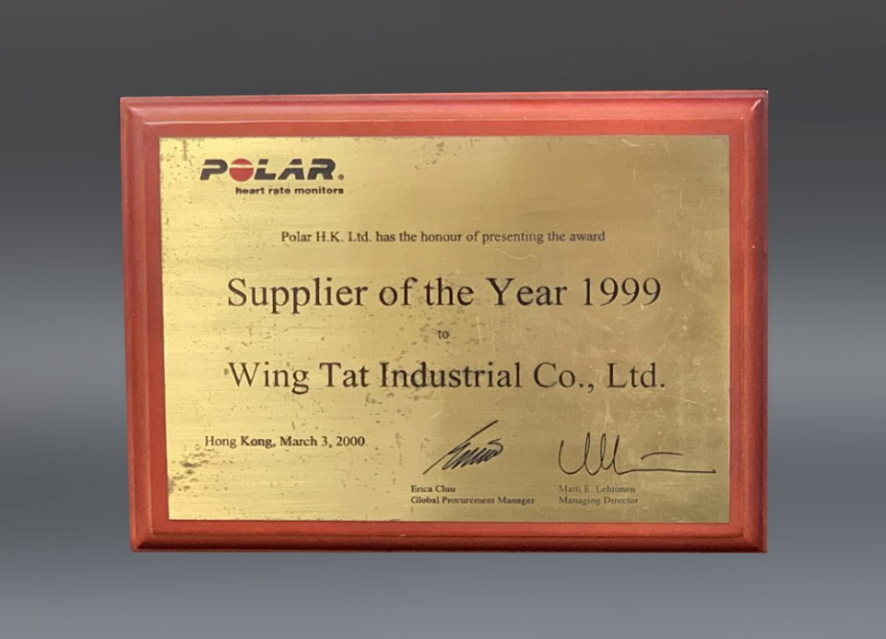
Honor Moment
The Supplier of Collaboration Award
Supplier of The Year Award
2004
2004
Supplier of The Year Award
Supplier of The Year Award
2000
1999

Slide 29
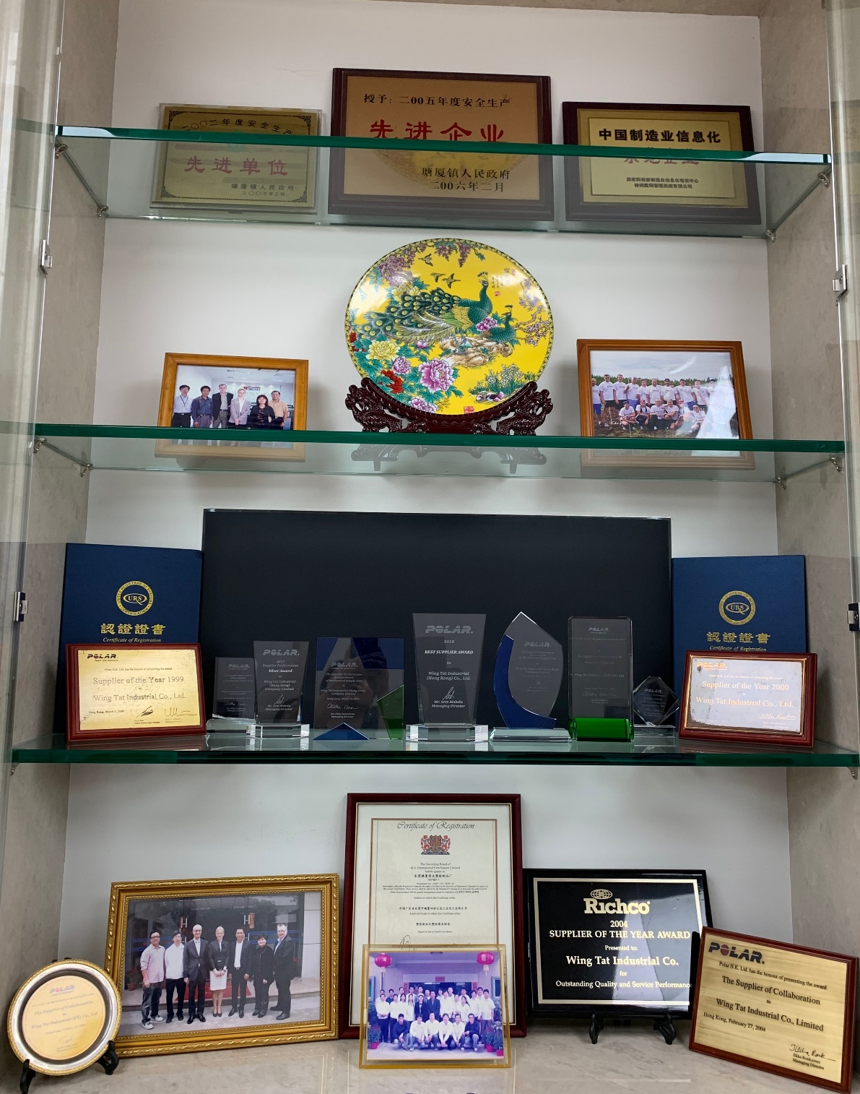
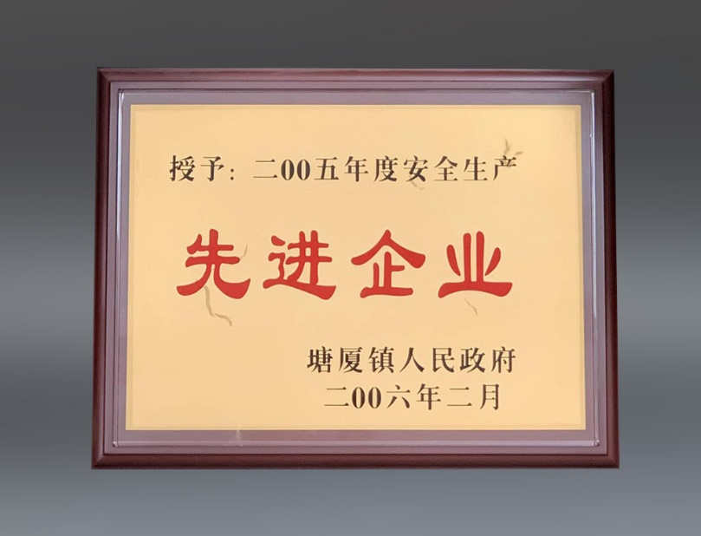
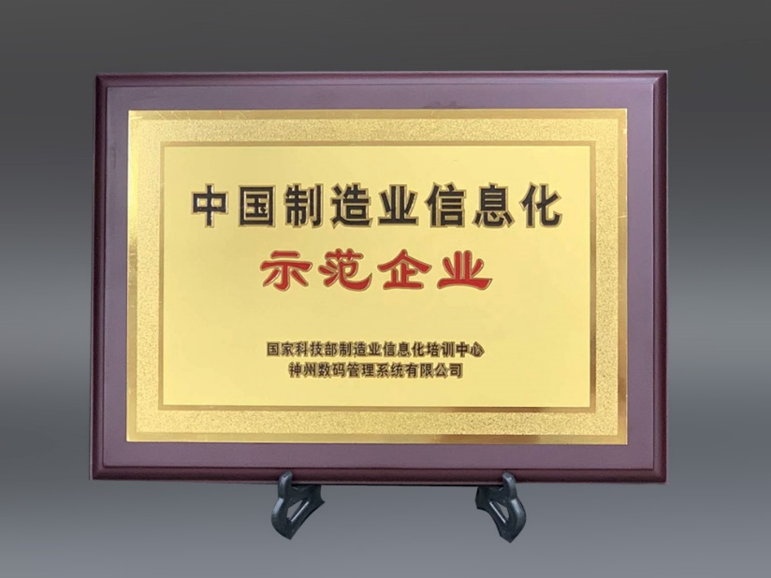
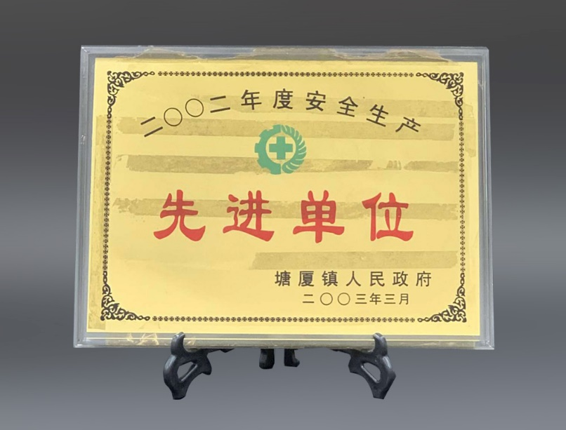
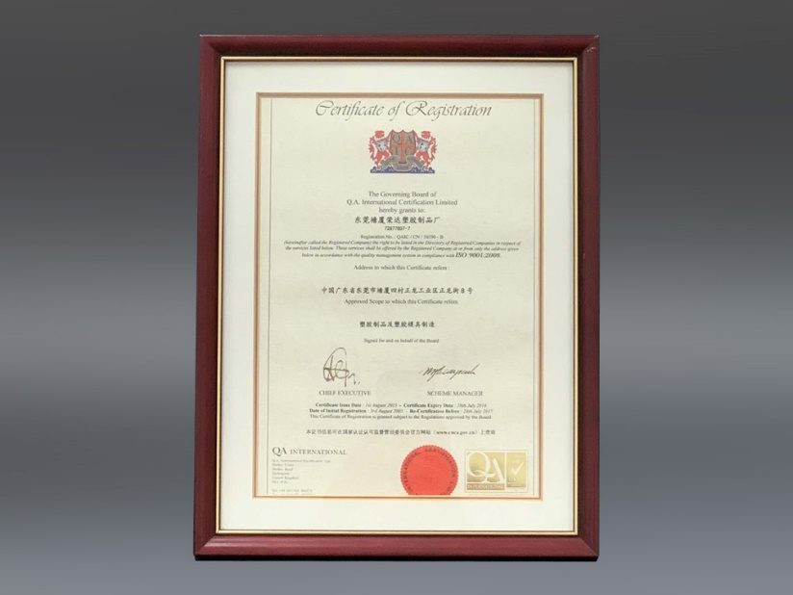
Qualification
Advanced Enterprise
China Manufacturing Demonstrative Enterprise
Advanced Enterprise

Slide 30
Stronger Together
Welcome to change and innovation.

Slide 31
Contact Us
Wing Tat Industrial (HK) Co. Ltd.
Dong Guan Wing Tat Industrial Co. Ltd.
Dong Guan Po Dan Industrial Co., Ltd
HK: 852-24670218 CN: 86-769-87920278
wingtat@wingtat.com.cn
www.wingtat.com.cn

Slide 32
THANKS FOR WATCHING
感謝您的觀賞

